Slide 1
General License Course Chapter 2
HF Operating Techniques
Procedures and Practices

Slide 2
Good Practices
The FCC regulations help stations using compatible modes stay together by dividing the amateur frequency bands.
Additional divisions of the band have been created by radio amateurs and are used on a strictly voluntary basis. These are called “Band Plans.”
When choosing a frequency for SSTV, RTTY, FT4/8, or PSK31 operation, check the band plan for recommended frequencies

Slide 3
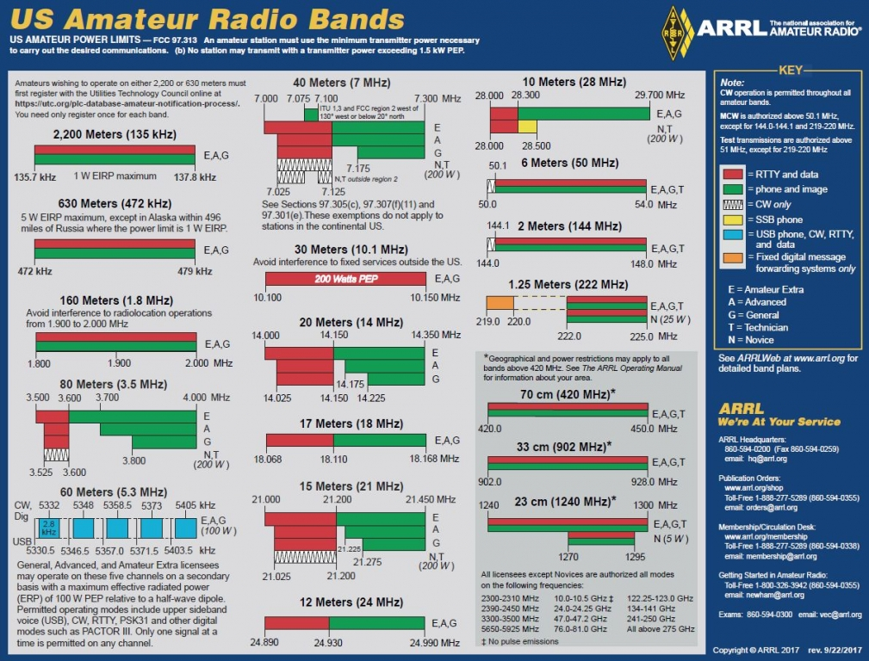
Meters vs. Frequency: 300 ÷ Freq (MHz) = Wavelength (Meters)
300 ÷ 14.2 MHz ≈ 20 Meters

Slide 4
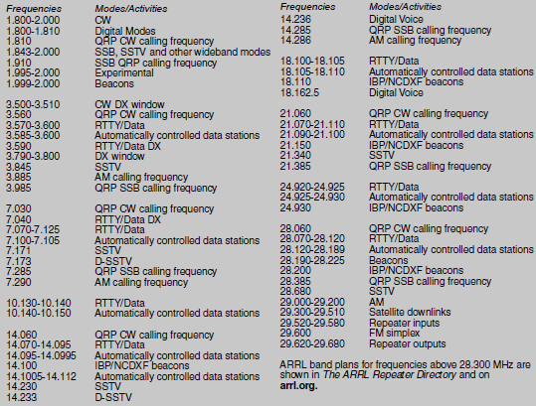

Slide 5
Good Practices
Choosing a frequency is critical - generally high bands during the day, low bands at night (AND day for local) On HF, perfectly clear channels are rare
Be sure the chosen frequency (and mode) is within your license privileges and agrees with the accepted voluntary band plan, then listen, listen, listen to be sure the frequency is open
Ask if the frequency is in use (“Is the frequency in use? This is AI2N”) twice. If using CW or digital modes, send: “QRL? DE AI2N”
Tune around, listen to others operating, emulate them

Slide 6
Nets and Schedules
Many on-the-air activities are scheduled in advance
Courtesy and flexibility are required by everyone – have a backup plan
If you’re in a QSO and another station requests the use of the frequency for a regularly-scheduled activity or net, try to accommodate the request
If you’re the net control and the net’s chosen frequency is busy, find a clear frequency

Slide 7
Good Practices
Except during FCC-declared emergencies no one “owns” a frequency – have a “Plan B”, practice common courtesy
If propagation changes during your contact and you notice increasing interference from other activity on the same frequency, attempt to resolve the problem to everyone’s satisfaction.
Operation with some QRM present IS a valuable skill to acquire.

Slide 8
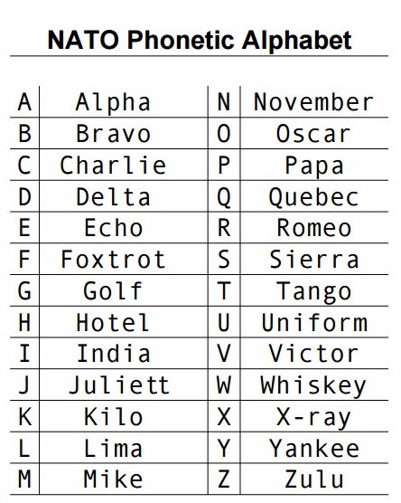
Standardized phonetics are important on HF!

Slide 9
Transceiver Operation
Operating a transceiver in "split" mode means that the transceiver is set to different transmit and receive frequencies.
A common use for the dual VFO feature on a transceiver is to permit ease of monitoring of two different receive frequencies simultaneously.
Only one frequency will be selected for transmit. Both receivers will be off during transmit.

Slide 10
Transceiver Split Operation
5J0X (San Andres Island) calling CQ on 28007 KHz – listening UP
Several stations calling -
GA3YOR responding on 28008.31 Khz
(it took a while for me to find him; the DX station also had trouble with QRM)
C:\Users\ai2n\Videos\General Course - Videos\Split_Mode_Demo.wmv

Slide 11
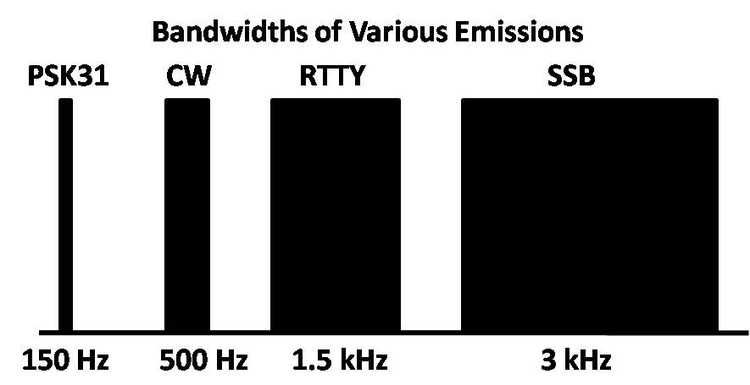
Good Practices
Try to put enough separation between your signal and adjacent signals to minimize interference.
On CW – 150 to 500 Hz
On SSB – 2 to 3 kHz

Slide 12
Take Quiz 1

Slide 13
G2B01 - Which of the following is true concerning access to frequencies?
A. Nets have priority
B. QSOs in progress have priority
C. Except during emergencies, no amateur station has priority access to any frequency
D. Contest operations should yield to non-contest use of frequencies

Slide 14
G2B01 - Which of the following is true concerning access to frequencies?
A. Nets have priority
B. QSOs in progress have priority
C. Except during emergencies, no amateur station has priority access to any frequency
D. Contest operations should yield to non-contest use of frequencies

Slide 15
G2B03 - What is good amateur practice if propagation changes during a contact creating interference from other stations using the frequency?
A. Advise the interfering stations that you are on the frequency and that you have priority
B. Decrease power and continue to transmit
C. Attempt to resolve the interference problem with the other stations in a mutually acceptable manner
D. Switch to the opposite sideband

Slide 16
G2B03 - What is good amateur practice if propagation changes during a contact creating interference from other stations using the frequency?
A. Advise the interfering stations that you are on the frequency and that you have priority
B. Decrease power and continue to transmit
C. Attempt to resolve the interference problem with the other stations in a mutually acceptable manner
D. Switch to the opposite sideband

Slide 17
G2B04 - When selecting a CW transmitting frequency, what minimum separation from other stations should be used to minimize interference to stations on adjacent frequencies?
A. 5 Hz to 50 Hz
B. 150 Hz to 500 Hz
C. 1 kHz to 3 kHz
D. 3 kHz to 6 kHz

Slide 18
G2B04 - When selecting a CW transmitting frequency, what minimum separation from other stations should be used to minimize interference to stations on adjacent frequencies?
A. 5 Hz to 50 Hz
B. 150 Hz to 500 Hz
C. 1 kHz to 3 kHz
D. 3 kHz to 6 kHz

Slide 19
G2B05 - When selecting an SSB transmitting frequency, what minimum separation should be used to minimize interference to stations on adjacent frequencies?
A. 5 Hz to 50 Hz
B. 150 Hz to 500 Hz
C. 2 kHz to 3 kHz
D. Approximately 6 kHz

Slide 20
G2B05 - When selecting an SSB transmitting frequency, what minimum separation should be used to minimize interference to stations on adjacent frequencies?
A. 5 Hz to 50 Hz
B. 150 Hz to 500 Hz
C. 2 kHz to 3 kHz
D. Approximately 6 kHz

Slide 21
G2B06 - How can you avoid harmful interference on an apparently clear frequency before calling CQ on CW or phone?
A. Send "QRL?" on CW, followed by your call sign; or, if using phone, ask if the frequency is in use, followed by your call sign
B. Listen for 2 minutes before calling CQ
C. Send the letter "V" in Morse code several times and listen for a response, or say "test" several times and listen for a response
D. Send "QSY" on CW or if using phone, announce "the frequency is in use," then give your call sign and listen for a response

Slide 22
G2B06 - How can you avoid harmful interference on an apparently clear frequency before calling CQ on CW or phone?
A. Send "QRL?" on CW, followed by your call sign; or, if using phone, ask if the frequency is in use, followed by your call sign
B. Listen for 2 minutes before calling CQ
C. Send the letter "V" in Morse code several times and listen for a response, or say "test" several times and listen for a response
D. Send "QSY" on CW or if using phone, announce "the frequency is in use," then give your call sign and listen for a response

Slide 23
G2B07 - Which of the following complies with commonly accepted amateur practice when choosing a frequency on which to initiate a call?
A. Listen on the frequency for at least two minutes to be sure it is clear
B. Identify your station by transmitting your call sign at least 3 times
C. Follow the voluntary band plan
D. All these choices are correct

Slide 24
G2B07 - Which of the following complies with commonly accepted amateur practice when choosing a frequency on which to initiate a call?
A. Listen on the frequency for at least two minutes to be sure it is clear
B. Identify your station by transmitting your call sign at least 3 times
C. Follow the voluntary band plan
D. All these choices are correct
In practice all these answers are -partly-correct...

Slide 25
G2C04 - What does the Q signal "QRL?" mean?
A. "Will you keep the frequency clear?"
B. "Are you operating full break-in?" or "Can you operate full break-in?"
C. "Are you listening only for a specific station?"
D. "Are you busy?" or "Is this frequency in use?"

Slide 26
G2C04 - What does the Q signal "QRL?" mean?
A. "Will you keep the frequency clear?"
B. "Are you operating full break-in?" or "Can you operate full break-in?"
C. "Are you listening only for a specific station?"
D. "Are you busy?" or "Is this frequency in use?"

Slide 27
G2D07 - Which of the following are examples of the NATO Phonetic Alphabet?
A. Able, Baker, Charlie, Dog
B. Adam, Boy, Charles, David
C. America, Boston, Canada, Denmark
D. Alpha, Bravo, Charlie, Delta

Slide 28
G2D07 - Which of the following are examples of the NATO Phonetic Alphabet?
A. Able, Baker, Charlie, Dog
B. Adam, Boy, Charles, David
C. America, Boston, Canada, Denmark
D. Alpha, Bravo, Charlie, Delta

Slide 29
G4A12 - Which of the following is a common use of the dual-VFO feature on a transceiver?
A. To allow transmitting on two frequencies at once
B. To permit full duplex operation -- that is, transmitting and receiving at the same time
C. To transmit on one frequency and listen on another
D. To improve frequency accuracy by allowing variable frequency output (VFO) operation

Slide 30
G4A12 - Which of the following is a common use of the dual-VFO feature on a transceiver?
A. To allow transmitting on two frequencies at once
B. To permit full duplex operation -- that is, transmitting and receiving at the same time
C. To transmit on one frequency and listen on another
D. To improve frequency accuracy by allowing variable frequency output (VFO) operation

Slide 31
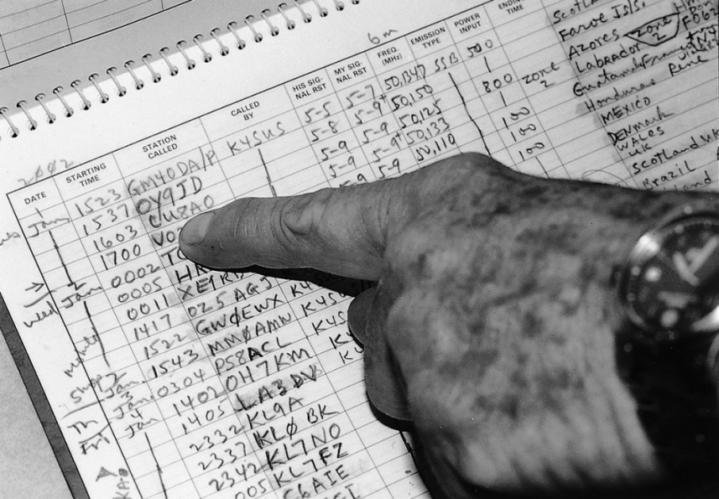
Making Contacts
Many amateurs keep a written or electronic log, even though the FCC does not require it, to help with a reply if the FCC requests information. It's also handy to keep track of awards or QSLs
Many types of digital logging software are available
The following information is traditionally contained in a station log:
- Date and time of contact
- Band and/or frequency of the contact
- Call sign of station contacted and the signal report given

Slide 32
Basic Operating
Operating techniques on HF are different from VHF and UHF FM operation
Not “channelized” (usually) - you choose the frequency
Often not as clear/audible, more prone to fading/QRM
CQ – Calling any station - anyone anywhere could answer. Repeat “CQ” several times, say “this is”, says your call sign a couple times, then listen.
CQ DX means calling stations other than in one’s own country (for us, outside the lower 48 States)
To join an on-going QSO, give your call sign once during a pause in the conversation (do NOT say “Break”!)

Slide 33
Basic Operating
Also:
During contests, you’ll generally hear …
“CQ Contest”, “CQ test”, or
“CQ from special event station”
or
CQ for stations from certain areas …
“CQ North America” or “CQ California”

Slide 34
Band Plans
Example of the 20 meter band plan:
14.060 QRP CW calling frequency
14.070-14.095 RTTY/Data
14.074 – FT8
14.080 - FT4
14.095-14.0995 Automatically controlled data
14.100 IBP/NCDXF beacons
14.1005-14.112 Automatically controlled data
14.230 SSTV
On 6 meters, the voluntary band plan sets aside from
50.1 to 50.125 MHz as a “DX” window.
(in our case, for stations outside the lower 48 States)

Slide 35
Operating Procedures
FCC rules require records be kept of the gain of your antenna on the 60 meter band if your antenna is other than a dipole.
Dipole gain is used as baseline (reference)
Must not exceed 100 watts effective radiated power output.
Notes kept in station logbook as permanent record
Logs are just plain handy

Slide 36
Operating Procedures
You must always identify your station per normal FCC regulations, including during participation in a contest.
97.119 Station identification:
(a) Each amateur station...must transmit its assigned call sign on its transmitting channel at the end of each communication, and at least every 10 minutes during a communication...

Slide 37
Managing Interference
Interference occurs for several reasons
QRM – Interference from other signals
QRN – Static (storms, motors, power lines, etc.)
Harmful interference – Seriously degrades, obstructs, or repeatedly interrupts communication
Deliberate interference – Malicious, willful
Rare – don’t engage, just avoid it

Slide 38
Types of Interference
- Harmful
Defined by FCC 97.3(a)(23) as “interference which … seriously degrades, obstructs or repeatedly interrupts a radio communication service operating in accordance with the Radio Regulations”
It’s not always illegal, but needs to be resolved to keep communicating
- Malicious, deliberate or willful
Specifically forbidden by FCC 97.101(d)

Slide 39
Managing Interference
Know the strengths and weaknesses of your station and how to use your filtering and noise reduction features
Keep your transmitted signal clean
Reacting to Interference: No one owns any frequency, be flexible. Change your frequency (QSY) if necessary
During scheduled contacts or nets, identify a backup frequency in case of interference or poor band conditions
Keep a cool head … don’t allow harmful interference to turn into deliberate interference!

Slide 40
Take Quiz 2

Slide 41
G1C04 - Which of the following is required by the FCC rules when operating in the 60-meter band?
A. If you are using an antenna other than a dipole, you must keep a record of the gain of your antenna
B. You must keep a record of the date, time, frequency, power level, and stations worked
C. You must keep a record of all third-party traffic
D. You must keep a record of the manufacturer of your equipment and the antenna used

Slide 42
G1C04 - Which of the following is required by the FCC rules when operating in the 60-meter band?
A. If you are using an antenna other than a dipole, you must keep a record of the gain of your antenna
B. You must keep a record of the date, time, frequency, power level, and stations worked
C. You must keep a record of all third-party traffic
D. You must keep a record of the manufacturer of your equipment and the antenna used

Slide 43
G2A08 - What is the recommended way to break into a phone contact?
A. Say "QRZ" several times, followed by your call sign
B. Say your call sign once
C. Say "Breaker Breaker"
D. Say "CQ" followed by the call sign of either station

Slide 44
G2A08 - What is the recommended way to break into a phone contact?
A. Say "QRZ" several times, followed by your call sign
B. Say your call sign once
C. Say "Breaker Breaker"
D. Say "CQ" followed by the call sign of either station

Slide 45
G2A11 - Generally, who should respond to a station in the contiguous 48 states calling "CQ DX"?
A. Any caller is welcome to respond
B. Only stations in Germany
C. Any stations outside the lower 48 states
D. Only contest stations

Slide 46
G2A11 - Generally, who should respond to a station in the contiguous 48 states calling "CQ DX"?
A. Any caller is welcome to respond
B. Only stations in Germany
C. Any stations outside the lower 48 states
D. Only contest stations

Slide 47
G2B08 - What is the voluntary band plan restriction for US stations transmitting within the 48 contiguous states in the 50.1 MHz to 50.125 MHz band segment?
A. Only contacts with stations not within the 48 contiguous states
B. Only contacts with other stations within the 48 contiguous states
C. Only digital contacts
D. Only SSTV contacts

Slide 48
G2B08 - What is the voluntary band plan restriction for US stations transmitting within the 48 contiguous states in the 50.1 MHz to 50.125 MHz band segment?
A. Only contacts with stations not within the 48 contiguous states
B. Only contacts with other stations within the 48 contiguous states
C. Only digital contacts
D. Only SSTV contacts

Slide 49
G2B10 - Which of the following is good amateur practice for net management?
A. Always use multiple sets of phonetics during check-in
B. Have a backup frequency in case of interference or poor conditions
C. Transmit the full net roster at the beginning of every session
D. All these choices are correct

Slide 50
G2B10 - Which of the following is good amateur practice for net management?
A. Always use multiple sets of phonetics during check-in
B. Have a backup frequency in case of interference or poor conditions
C. Transmit the full net roster at the beginning of every session
D. All these choices are correct

Slide 51
G2D05 - Which of the following indicates that you are looking for an HF contact with any station?
A. Sign your call sign once, followed by the words "listening for a call" -- if no answer, change frequency and repeat
B. Say "QTC" followed by "this is" and your call sign -- if no answer, change frequency and repeat
C. Repeat "CQ" a few times, followed by "this is," then your call sign a few times, then pause to listen, repeat as necessary
D. Transmit an unmodulated carried for approximately 10 seconds, followed by "this is" and your call sign, and pause to listen -- repeat as necessary

Slide 52
G2D05 - Which of the following indicates that you are looking for an HF contact with any station?
A. Sign your call sign once, followed by the words "listening for a call" -- if no answer, change frequency and repeat
B. Say "QTC" followed by "this is" and your call sign -- if no answer, change frequency and repeat
C. Repeat "CQ" a few times, followed by "this is," then your call sign a few times, then pause to listen, repeat as necessary
D. Transmit an unmodulated carried for approximately 10 seconds, followed by "this is" and your call sign, and pause to listen -- repeat as necessary

Slide 53
G2D08 - Why do many amateurs keep a station log?
A. The FCC requires a log of all international contacts
B. The FCC requires a log of all international third-party traffic
C. The log provides evidence of operation needed to renew a license without retest
D. To help with a reply if the FCC requests information about your station

Slide 54
G2D08 - Why do many amateurs keep a station log?
A. The FCC requires a log of all international contacts
B. The FCC requires a log of all international third-party traffic
C. The log provides evidence of operation needed to renew a license without retest
D. To help with a reply if the FCC requests information about your station

Slide 55
G2D09 - Which of the following is required when participating in a contest on HF frequencies?
A. Submit a log to the contest sponsor
B. Send a QSL card to the stations worked, or QSL via Logbook of The World
C. Identify your station according to normal FCC regulations
D. All these choices are correct

Slide 56
G2D09 - Which of the following is required when participating in a contest on HF frequencies?
A. Submit a log to the contest sponsor
B. Send a QSL card to the stations worked, or QSL via Logbook of The World
C. Identify your station according to normal FCC regulations
D. All these choices are correct

Slide 57
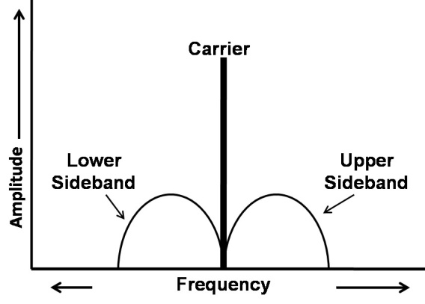
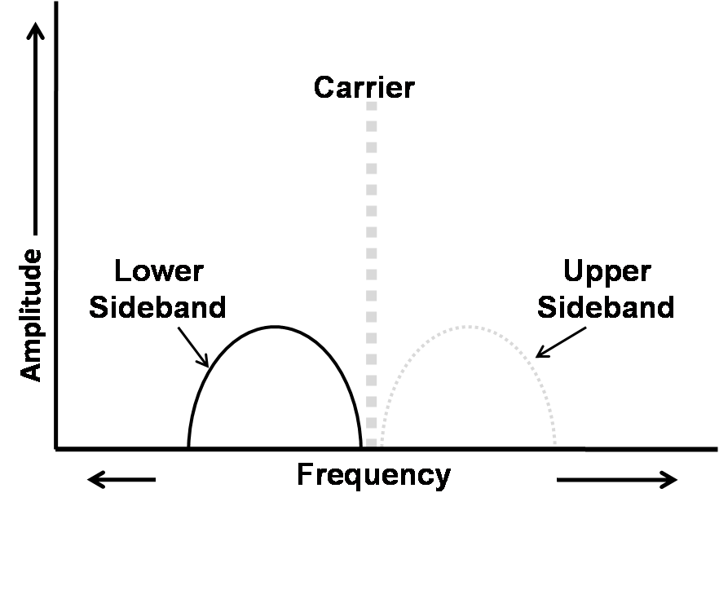
AM & SSB Modes
Amplitude Modulation (AM) and Single Sideband (SSB) Radiotelephone (voice)
On HF, SSB is the most common voice (phone) mode.
SSB (3 kHz) uses less bandwidth than AM (6 kHz) because only one sideband is transmitted; the carrier and the other sideband are suppressed. SSB also offers greater power efficiency.

Slide 58
AM & SSB Modes
Upper sideband (USB) is used on 14 MHz and higher (20 meters – 10 meters) and on 60 meters
Lower sideband (LSB) is used on and below 7 MHz (160 meters, 80 meters, and 40 meters)
Upper sideband is used on VHF and UHF bands (6 meters and up)
These conventions are commonly accepted amateur practice (not rules)

Slide 59
Digital Voice
Relatively new on HF bands
Operator’s voice converted to and from a digital stream via modem or sound card. Modem connects to a regular SSB transceiver
Fidelity comparable to regular SSB signals, but less affected by fading
Most popular digital voice modes: FreeDV and protocol developed by G4GUO

Slide 60
Image Modes
Image mode transmissions on HF encode
photos and graphics to tones
These tones are reconstructed as an image on a display
Allowed on same frequencies as voice, except for 60 meters
Most common image mode: Slow-scan television (SSTV)
Called slow because each image takes several seconds
Fast-scan amateur television (ATV) allows full motion video
Restricted to 432 MHz and higher frequency bands (due to wide bandwidth)

Slide 61

HF Receiving
Exchange signal reports at the beginning of a contact. Adjust controls, frequencies, procedures, etc. according to conditions
Also report any QRN (static) or QRM (interference) present.
“RST” Readability, Strength, and Tone (CW only). The higher the number the better (e.g., 489, 579, 599, or 5NN) - Readability (1-5) – Strength (1-9) – Tone (1-9)
On CW, add “C” to indicate that a signal is “chirpy” or unstable – example: 579C (more on CW soon)
C:\Users\ai2n\Videos\General Course - Videos\Chirp - HA5LV.wmv

Slide 62
Take Quiz 3

Slide 63
G2A01 - Which mode is most commonly used for voice communications on frequencies of 14 MHz or higher?
A. Upper sideband
B. Lower sideband
C. Suppressed sideband
D. Double sideband

Slide 64
G2A01 - Which mode is most commonly used for voice communications on frequencies of 14 MHz or higher?
A. Upper sideband
B. Lower sideband
C. Suppressed sideband
D. Double sideband

Slide 65
G2A02 - Which mode is most commonly used for voice communications on the 160-, 75-, and 40-meter bands?
A. Upper sideband
B. Lower sideband
C. Suppressed sideband
D. Double sideband

Slide 66
G2A02 - Which mode is most commonly used for voice communications on the 160-, 75-, and 40-meter bands?
A. Upper sideband
B. Lower sideband
C. Suppressed sideband
D. Double sideband

Slide 67
G2A03 - Which mode is most commonly used for SSB voice communications in the VHF and UHF bands?
A. Upper sideband
B. Lower sideband
C. Suppressed sideband
D. Double sideband

Slide 68
G2A03 - Which mode is most commonly used for SSB voice communications in the VHF and UHF bands?
A. Upper sideband
B. Lower sideband
C. Suppressed sideband
D. Double sideband

Slide 69
G2A04 - Which mode is most commonly used for voice communications on the 17- and 12-meter bands?
A. Upper sideband
B. Lower sideband
C. Suppressed sideband
D. Double sideband

Slide 70
G2A04 - Which mode is most commonly used for voice communications on the 17- and 12-meter bands?
A. Upper sideband
B. Lower sideband
C. Suppressed sideband
D. Double sideband

Slide 71
G2A05 - Which mode of voice communication is most commonly used on the HF amateur bands?
A. Frequency modulation
B. Double sideband
C. Single sideband
D. Single phase modulation

Slide 72
G2A05 - Which mode of voice communication is most commonly used on the HF amateur bands?
A. Frequency modulation
B. Double sideband
C. Single sideband
D. Single phase modulation

Slide 73
G2A06 - Which of the following is an advantage of using single sideband, as compared to other analog voice modes on the HF amateur bands?
A. Very high-fidelity voice modulation
B. Less subject to interference from atmospheric static crashes
C. Ease of tuning on receive and immunity to impulse noise
D. Less bandwidth used and greater power efficiency

Slide 74
G2A06 - Which of the following is an advantage of using single sideband, as compared to other analog voice modes on the HF amateur bands?
A. Very high-fidelity voice modulation
B. Less subject to interference from atmospheric static crashes
C. Ease of tuning on receive and immunity to impulse noise
D. Less bandwidth used and greater power efficiency

Slide 75
G2A07 - Which of the following statements is true of single sideband (SSB)?
A. Only one sideband and the carrier are transmitted; the other sideband is suppressed
B. Only one sideband is transmitted; the other sideband and carrier are suppressed
C. SSB is the only voice mode authorized on the 20-, 15-, and 10-meter amateur bands
D. SSB is the only voice mode authorized on the 160-, 75-, and 40-meter amateur bands

Slide 76
G2A07 - Which of the following statements is true of single sideband (SSB)?
A. Only one sideband and the carrier are transmitted; the other sideband is suppressed
B. Only one sideband is transmitted; the other sideband and carrier are suppressed
C. SSB is the only voice mode authorized on the 20-, 15-, and 10-meter amateur bands
D. SSB is the only voice mode authorized on the 160-, 75-, and 40-meter amateur bands

Slide 77
G2A09 - Why do most amateur stations use lower sideband on the 160-, 75-, and 40-meter bands?
A. Lower sideband is more efficient than upper sideband at these frequencies
B. Lower sideband is the only sideband legal on these frequency bands
C. Because it is fully compatible with an AM detector
D. It is commonly accepted amateur practice

Slide 78
G2A09 - Why do most amateur stations use lower sideband on the 160-, 75-, and 40-meter bands?
A. Lower sideband is more efficient than upper sideband at these frequencies
B. Lower sideband is the only sideband legal on these frequency bands
C. Because it is fully compatible with an AM detector
D. It is commonly accepted amateur practice

Slide 79
G2C07 - When sending CW, what does a "C" mean when added to the RST report?
A. Chirpy or unstable signal
B. Report was read from an S meter rather than estimated
C. 100 percent copy
D. Key clicks

Slide 80
G2C07 - When sending CW, what does a "C" mean when added to the RST report?
A. Chirpy or unstable signal
B. Report was read from an S meter rather than estimated
C. 100 percent copy
D. Key clicks

Slide 81
G2C10 - What does the Q signal "QRN" mean?
A. Send more slowly
B. Stop sending
C. Zero beat my signal
D. I am troubled by static

Slide 82
G2C10 - What does the Q signal "QRN" mean?
A. Send more slowly
B. Stop sending
C. Zero beat my signal
D. I am troubled by static

Slide 83
G2D11 - Why are signal reports typically exchanged at the beginning of an HF contact?
A. To allow each station to operate according to conditions
B. To be sure the contact will count for award programs
C. To follow standard radiogram structure
D. To allow each station to calibrate their frequency display

Slide 84
G2D11 - Why are signal reports typically exchanged at the beginning of an HF contact?
A. To allow each station to operate according to conditions
B. To be sure the contact will count for award programs
C. To follow standard radiogram structure
D. To allow each station to calibrate their frequency display

Slide 85
HF Transmitting – Phone
Push-to-talk – Just like on VHF/UHF
Voice-operated-transmit (VOX)
- Hands-free operation
- Possible false triggering due to background noise
- Adjust VOX gain, delay, and anti-VOX controls to
minimize problems

Slide 86
HF Phone Procedures and Abbreviations
CQ, Break, Over, Clear
Q-Signals – Heard on SSB/FM even though they were designed as shorthand for CW
Avoid “CB Talk” and 10-codes (“10-4”)
- Plain speech is more effective

Slide 87
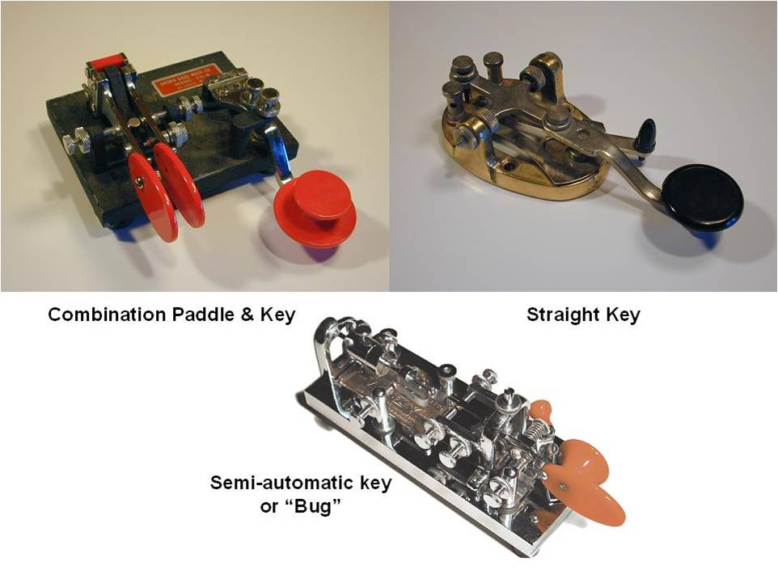
HF CW Transmitting
Morse code is alive and well in Amateur Radio
Though usually from at the low end of each band,
CW operation is permitted throughout all amateur bands
Morse ops use:
- Straight keys
- Iambic paddles
- Bugs
- Computers

Slide 88
CW Mode
CW (Morse code) – Found at the bottom of each HF band, but allowed to be transmitted on almost any amateur frequency
Speeds vary from 5 to 50 WPM - answer a CQ at the fastest speed you can copy, but NOT faster than the CQ
Most CW ops will slow down if you send “QRS” (send slower)
An electronic keyer can be used for automatic generation of strings of dots and dashes for CW operation.

Slide 89
QSK
Most radios offer full break-in (QSK) capability;
the transmitting station can receive between transmitted code characters and elements
The video shows a series of simulated dashes being sent.
Another signal can be heard between dashes.
C:\Users\ai2n\Videos\General Course - Videos\QSK_Demo.wmv

Slide 90
HF CW Transmitting
Zero beating is adjusting your transmit frequency to the frequency of a received signal, producing the same audio tone
A CW signal will be heard. Depressing the SPOT key emits a tone
to compare your transmit frequency to the receive frequency.
C:\Users\ai2n\Videos\General Course - Videos\Zero_Beat_Demo.wmv

Slide 91
CW Procedures / Abbreviations
Procedural signals like “K” (over) control the flow of the contact
Prosigns are two letters run together as a single Morse character, written with an overscore
End of formal Message
AR
SK
End of Communication
BT
Separation (between message text and other information)
KN
Listening only for specific station(s)

Slide 92
CW Procedures / Abbreviations
Abbreviations:
WX – Weather
CUL – See you later
TU – Thank you
73 – Best wishes
AGN – Again
FB - Fine Business (OK)
DE - From
Q-Signals:
QRN – Atmospheric noise
(static)
QRM – Man-made noise
QRV – Ready to receive
QSL – Acknowledge receipt
QRL – Frequency is in use
QRP – Low power, 5 W or less
Q-Signals can be a statement or made into a question by adding ?
Example: QSL? QSL

Slide 93
Emergency Operation
Events around world have demonstrated the value of Amateur Radio in times of disaster
All Amateur Radio operators should be familiar with emergency rules and procedures so they can contribute effectively when normal communications are unavailable
Emergency communications in any form take priority over all other types of amateur communication - it's why we exist

Slide 94
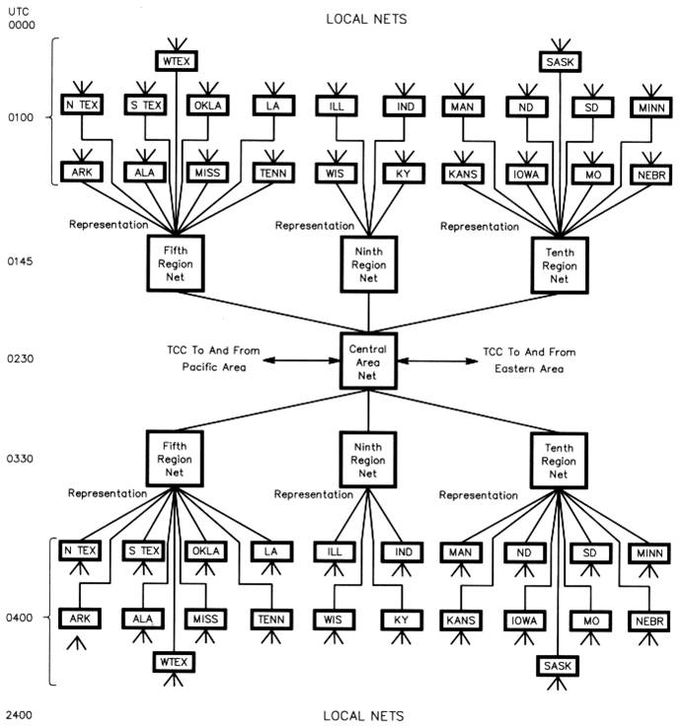
Nets and Emergency Operation
Three basic net (Network) types:
Traffic (relaying messages – shown at right)
Emergency communications
Social or topical

Slide 95
Nets and Emergency Operation
Net Control Station (NCS) – the operator in charge of a directed net.
The NCS runs the net. A “directed net” means all contacts are routed through the NCS.
Joining and leaving a net – checking in and checking out.
Before joining a net, listen for a while to learn the procedures of the net.

Slide 96
Emergency Operation
ARES – Amateur Radio Emergency Service is organized by the American Radio Relay League
Any licensed ham can be a member
ARRL membership is required for official appointments
Teams are lead by Emergency Coordinators (ECs) at the local level, District Emergency Coordinators (DECs) in larger areas like counties
Leadership is handled by the ARRL Section Emergency Coordinator (SEC)
The mission is to provide communication assistance to local and regional government and relief agencies

Slide 97
Emergency Operation
RACES – Radio Amateur Civil Emergency Service is sponsored through government agencies (City, County, State)
RACES is a specific part of the Amateur Service and is governed by the FCC rules to provide essential communications for State and local governments in time of emergency
To participate, you must register with a local Civil Defense or Emergency Management organization
Only an FCC licensed amateur may be a control operator of a RACES station
RACES training drills/tests maybe conducted for a maximum of 1 hour per week without special authorization

Slide 98
Emergency Operation
The FCC rules state that during an emergency or disaster, an amateur station may make “transmissions necessary to meet essential communication needs and to facilitate relief actions.”
Routine emergency communications are conducted on any frequencies authorized to the station control operator.
There are exceptions to the rules that allow amateurs to use any means and any frequency necessary to provide emergency communication.

Slide 99
Emergency Operation
FCC Rule Exception
When there is an immediate threat to the safety of life or property
“No provision of these rules prevents the use by an amateur station of any means of radio communication at its disposal to provide essential communication needs…”

Slide 100
Distress Calls
What do you do if you hear a distress call?
Immediately suspend your existing contact
Immediately contact the station calling for help to let them know that you hear them
Do your best to obtain assistance for the station in distress

Slide 101
Distress Calls
Stand by to receive:
The location of the emergency
The nature of the emergency
What assistance is required
Relay the information to the proper authorities and stay on frequency for further information or until help arrives

Slide 102
Distress Calls
What do you do if you are the station in distress?
On a voice mode say “Mayday Mayday Mayday” or on CW send “SOS SOS SOS” followed by “any station come in please”
Identify your transmission with your call sign
Give your location with enough detail to be located
State the nature of the situation/emergency
Describe the type of assistance you require and provide any other pertinent information

Slide 103
Distress Calls
Unidentified transmissions outside the amateur bands are permitted if required to provide the necessary emergency communications
Use whichever frequency has the best chance of communicating the distress message
The same rules apply to you if you hear a distress call - answer if you can, whatever the frequency
The risk of immediate loss of life and property overrides rules for normal operation

Slide 104
Take Quiz 4

Slide 105
G2A10 - Which of the following statements is true of VOX operation versus PTT operation?
A. The received signal is more natural sounding
B. It allows "hands free" operation
C. It occupies less bandwidth
D. It provides more power output

Slide 106
G2A10 - Which of the following statements is true of VOX operation versus PTT operation?
A. The received signal is more natural sounding
B. It allows "hands free" operation
C. It occupies less bandwidth
D. It provides more power output

Slide 107
G2B11 - How often may RACES training drills and tests be routinely conducted without special authorization?
A. No more than 1 hour per month
B. No more than 2 hours per month
C. No more than 1 hour per week
D. No more than 2 hours per week

Slide 108
G2B11 - How often may RACES training drills and tests be routinely conducted without special authorization?
A. No more than 1 hour per month
B. No more than 2 hours per month
C. No more than 1 hour per week
D. No more than 2 hours per week

Slide 109
G2C01 - Which of the following describes full break-in CW operation (QSK)?
A. Breaking stations send the Morse code prosign "BK"
B. Automatic keyers, instead of hand keys, are used to send Morse code
C. An operator must activate a manual send/receive switch before and after every transmission
D. Transmitting stations can receive between code characters and elements

Slide 110
G2C01 - Which of the following describes full break-in CW operation (QSK)?
A. Breaking stations send the Morse code prosign "BK"
B. Automatic keyers, instead of hand keys, are used to send Morse code
C. An operator must activate a manual send/receive switch before and after every transmission
D. Transmitting stations can receive between code characters and elements

Slide 111
G2C02 - What should you do if a CW station sends "QRS?"
A. Send slower
B. Change frequency
C. Increase your power
D. Repeat everything twice

Slide 112
G2C02 - What should you do if a CW station sends "QRS?"
A. Send slower
B. Change frequency
C. Increase your power
D. Repeat everything twice

Slide 113
G2C03 - What does it mean when a CW operator sends "KN" at the end of a transmission?
A. No US stations should call
B. Operating full break-in
C. Listening only for a specific station or stations
D. Closing station now

Slide 114
G2C03 - What does it mean when a CW operator sends "KN" at the end of a transmission?
A. No US stations should call
B. Operating full break-in
C. Listening only for a specific station or stations
D. Closing station now

Slide 115
G2C05 - What is the best speed to use when answering a CQ in Morse code?
A. The fastest speed at which you are comfortable copying, but no slower than the CQ
B. The fastest speed at which you are comfortable copying, but no faster than the CQ
C. At the standard calling speed of 10 wpm
D. At the standard calling speed of 5 wpm

Slide 116
G2C05 - What is the best speed to use when answering a CQ in Morse code?
A. The fastest speed at which you are comfortable copying, but no slower than the CQ
B. The fastest speed at which you are comfortable copying, but no faster than the CQ
C. At the standard calling speed of 10 wpm
D. At the standard calling speed of 5 wpm

Slide 117
G2C06 - What does the term "zero beat" mean in CW operation?
A. Matching the speed of the transmitting station
B. Operating split to avoid interference on frequency
C. Sending without error
D. Matching the transmit frequency to the frequency of a received signal

Slide 118
G2C06 - What does the term "zero beat" mean in CW operation?
A. Matching the speed of the transmitting station
B. Operating split to avoid interference on frequency
C. Sending without error
D. Matching the transmit frequency to the frequency of a received signal

Slide 119
G2C08 - What prosign is sent to indicate the end of a formal message when using CW?
A. SK
B. BK
C. AR
D. KN

Slide 120
G2C08 - What prosign is sent to indicate the end of a formal message when using CW?
A. SK
B. BK
C. AR
D. KN

Slide 121
G2C09 - What does the Q signal "QSL" mean?
A. Send slower
B. We have already confirmed the contact
C. I have received and understood
D. We have worked before

Slide 122
G2C09 - What does the Q signal "QSL" mean?
A. Send slower
B. We have already confirmed the contact
C. I have received and understood
D. We have worked before

Slide 123
G2C11 - What does the Q signal "QRV" mean?
A. You are sending too fast
B. There is interference on the frequency
C. I am quitting for the day
D. I am ready to receive

Slide 124
G2C11 - What does the Q signal "QRV" mean?
A. You are sending too fast
B. There is interference on the frequency
C. I am quitting for the day
D. I am ready to receive

Slide 125
G4A10 - What is the function of an electronic keyer?
A. Automatic transmit/receive switching
B. Automatic generation of dots and dashes for CW operation
C. To allow time for switching the antenna from the receiver to the transmitter
D. Computer interface for PSK and RTTY operation

Slide 126
G4A10 - What is the function of an electronic keyer?
A. Automatic transmit/receive switching
B. Automatic generation of dots and dashes for CW operation
C. To allow time for switching the antenna from the receiver to the transmitter
D. Computer interface for PSK and RTTY operation

Slide 127
G2B02 - What is the first thing you should do if you are communicating with another amateur station and hear a station in distress break in?
A. Inform your local emergency coordinator
B. Acknowledge the station in distress and determine what assistance may be needed
C. Immediately decrease power to avoid interfering with the station in distress
D. Immediately cease all transmissions

Slide 128
G2B02 - What is the first thing you should do if you are communicating with another amateur station and hear a station in distress break in?
A. Inform your local emergency coordinator
B. Acknowledge the station in distress and determine what assistance may be needed
C. Immediately decrease power to avoid interfering with the station in distress
D. Immediately cease all transmissions

Slide 129
G2B09 - Who may be the control operator of an amateur station transmitting in RACES to assist relief operations during a disaster?
A. Only a person holding an FCC-issued amateur operator license
B. Only a RACES net control operator
C. A person holding an FCC-issued amateur operator license or an appropriate government official
D. Any control operator when normal communication systems are operational

Slide 130
G2B09 - Who may be the control operator of an amateur station transmitting in RACES to assist relief operations during a disaster?
A. Only a person holding an FCC-issued amateur operator license
B. Only a RACES net control operator
C. A person holding an FCC-issued amateur operator license or an appropriate government official
D. Any control operator when normal communication systems are operational

Slide 131
Next Week - Chapter 3
Start learning to identify the bands, wavelength vs. frequency!

